Slide 1
K-means
K-means Clustering
Specify the number of clusters (K).
Define what is similar or dissimilar
Euclidean Distance!

Slide 2
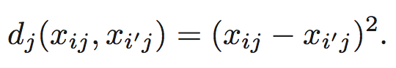
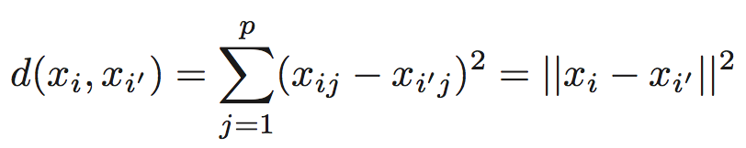
Definition for (Dis)similarity
Euclidean Distance

Slide 3
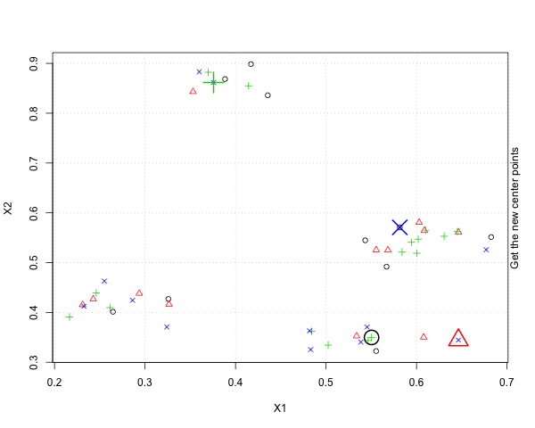
K-means Algorithm

Slide 4
Finding the best k
TOTAL Sum of Squares = WITHIN Groups SS + BETWEEN Groups SS
(TOTAL variance = WITHIN variance + BETWEEN variance)

Slide 5
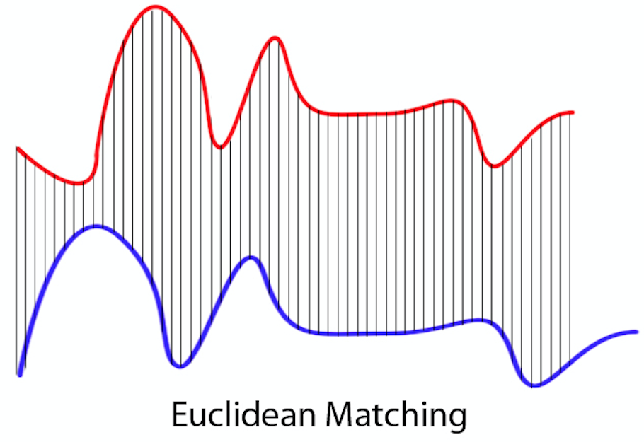
Distance Between Two Time Series

Slide 6
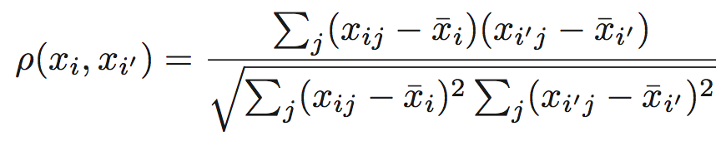
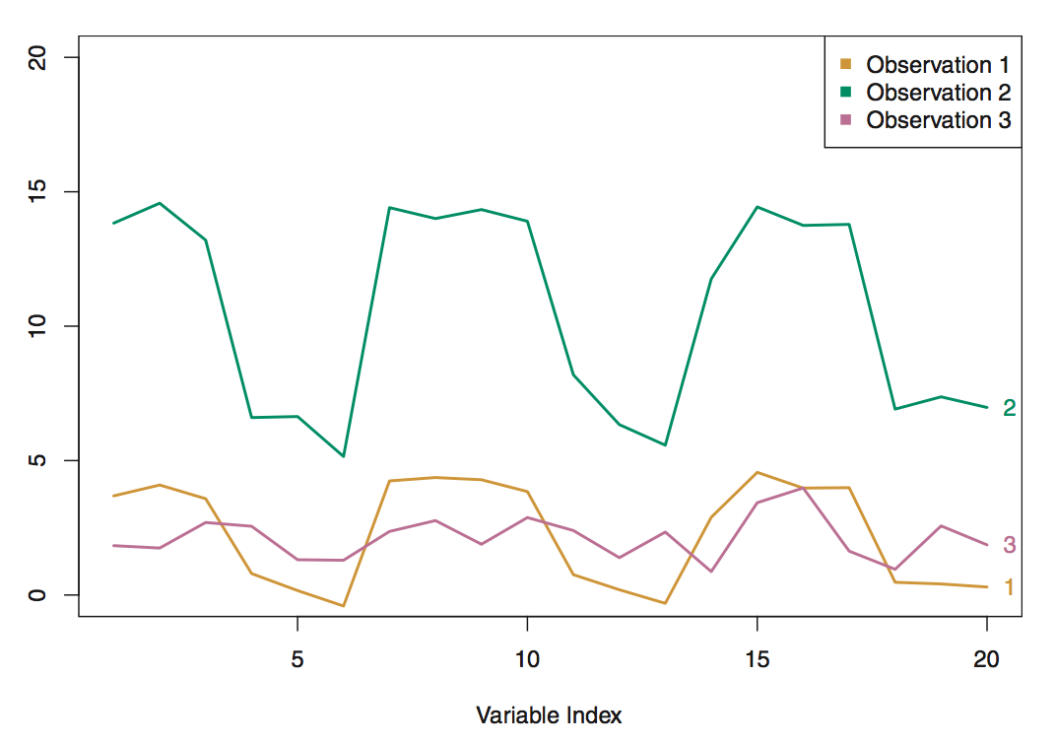
Distance between Time Series
Correlation Distance may be a better idea!

Slide 7
All 124 stocks Data

Slide 8
One Year Data

Slide 9
Oct. 2016 ~ Dec. 2016

Slide 10
Jan. 2017 ~ Mar. 2017

Slide 11
Apr. 2017 ~ Jun. 2017

Slide 12
Jul. 2017 ~ Sep. 2017

